Slide 1


Application Layer
COMPSCI 453 Computer Networks
Professor Jim Kurose
College of Information and Computer Sciences
University of Massachusetts
Principles of network applications
Web and HTTP
E-mail, SMTP, IMAP
The Domain Name System: DNS
P2P applications
video streaming, CDNs
socket programming with UDP and TCP
Class textbook:
Computer Networking: A Top-Down Approach (8th ed.)
J.F. Kurose, K.W. Ross
Pearson, 2020
http://gaia.cs.umass.edu/kurose_ross

Slide 2




Video Streaming and CDNs: context
stream video traffic: major consumer of Internet bandwidth
  Netflix, YouTube, Amazon Prime: 80% of residential ISP traffic (2020)
challenge: scale - how to reach ~1B users?
challenge: heterogeneity
  different users have different capabilities (e.g., wired versus mobile; bandwidth rich versus bandwidth poor)
solution: distributed, application-level infrastructure

Slide 3

Multimedia: video
spatial coding example: instead of sending N values of same color (all purple), send only two values: color value (purple) and number of repeated values (N)
video: sequence of images displayed at constant rate
  e.g., 24 images/sec
digital image: array of pixels
  each pixel represented by bits
coding: use redundancy within and between images to decrease # bits used to encode image
  spatial (within image)
  temporal (from one image to next)
……………………..
……………….…….
frame i
temporal coding example: instead of sending complete frame at i+1, send only differences from frame i
frame i+1

Slide 4
Multimedia: video
spatial coding example: instead of sending N values of same color (all purple), send only two values: color value (purple) and number of repeated values (N)
CBR: (constant bit rate): video encoding rate fixed
VBR: (variable bit rate): video encoding rate changes as amount of spatial, temporal coding changes
examples:
  MPEG 1 (CD-ROM) 1.5 Mbps
  MPEG2 (DVD) 3-6 Mbps
  MPEG4 (often used in Internet, 64Kbps – 12 Mbps)
……………………..
……………….…….
frame i
temporal coding example: instead of sending complete frame at i+1, send only differences from frame i
frame i+1

Slide 5


Streaming stored video
simple scenario:
Internet
video server
(stored video)
client
Main challenges:
server-to-client bandwidth will vary over time, with changing network congestion levels (in house, access network, network core, video server)
packet loss, delay due to congestion will delay playout, or result in poor video quality

Slide 6
Streaming stored video
Cumulative data
2. video
sent
video
recorded (e.g., 30 frames/sec)
3. video received, played out at client
(30 frames/sec)
network delay
(fixed in this example)
time
streaming: at this time, client playing out early part of video, while server still sending later part of video

Slide 7
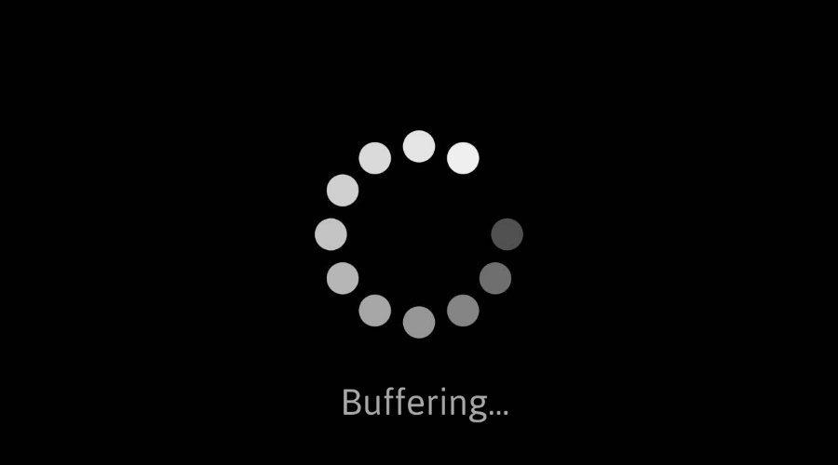
Streaming stored video: challenges
continuous playout constraint: during client video playout, playout timing must match original timing
  … but network delays are variable (jitter), so will need client-side buffer to match continuous playout constraint
other challenges:
  client interactivity: pause, fast-forward, rewind, jump through video
  video packets may be lost, retransmitted

Slide 8
Streaming stored video: playout buffering
constant bit
rate video
transmission
client video
reception
constant bit
rate video
playout at client
Cumulative data
variable
network
delay
buffered
video
client playout
delay
time
client-side buffering and playout delay: compensate for network-added delay, delay jitter

Slide 9
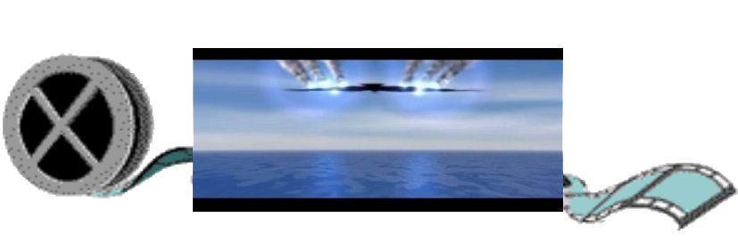
Streaming multimedia: DASH
Dynamic, Adaptive Streaming over HTTP
server:
  divides video file into multiple chunks
  each chunk encoded at multiple different rates
  different rate encodings stored in different files
  files replicated in various CDN nodes
  manifest file: provides URLs for different chunks
...
...
?
...
client
client:
  periodically estimates server-to-client bandwidth
  consulting manifest, requests one chunk at a time
    chooses maximum coding rate sustainable given current bandwidth
    can choose different coding rates at different points in time (depending on available bandwidth at time), and from different servers

Slide 10

Streaming multimedia: DASH
“intelligence” at client: client determines
  when to request chunk (so that buffer starvation, or overflow does not occur)
  what encoding rate to request (higher quality when more bandwidth available)
...
...
?
...
client
  where to request chunk (can request from URL server that is “close” to client or has high available bandwidth)
Streaming video = encoding + DASH + playout buffering

Slide 11
Content distribution networks (CDNs)
challenge: how to stream content (selected from millions of videos) to hundreds of thousands of simultaneous users?
option 1: single, large “mega-server”
  single point of failure
  point of network congestion
  long (and possibly congested) path to distant clients
….quite simply: this solution doesn’t scale

Slide 12


Content distribution networks (CDNs)
challenge: how to stream content (selected from millions of videos) to hundreds of thousands of simultaneous users?
option 2: store/serve multiple copies of videos at multiple geographically distributed sites (CDN)
  enter deep: push CDN servers deep into many access networks
    close to users
    Akamai: 240,000 servers deployed
    in > 120 countries (2015)
  bring home: smaller number (10’s) of larger clusters in POPs near access nets
    used by Limelight

Slide 13



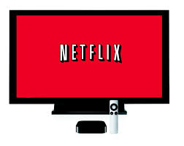
Content distribution networks (CDNs)
CDN: stores copies of content (e.g. MADMEN) at CDN nodes
subscriber requests content, service provider returns manifest
  using manifest, client retrieves content at highest supportable rate
  may choose different rate or copy if network path congested
…
…
…
manifest file
…
where’s Madmen?
…
…
Notes:
‹#›
Akamai: 100,000+ servers in 1000+ clusters in 1000+ networks in 70+ countries serving trillions of requests a day.
How many people use Netflix?

Slide 14
Content distribution networks (CDNs)
OTT: “over the top”
…
…
Internet host-host communication as a service
…
…
OTT challenges: coping with a congested Internet from the “edge”
  what content to place in which CDN node?
  from which CDN node to retrieve content? At which rate?
…
…
Notes:
‹#›
peak load: 7million viewers, 2 Tbytes via

Slide 15

Application Layer
COMPSCI 453 Computer Networks
Professor Jim Kurose
College of Information and Computer Sciences
University of Massachusetts
Principles of network applications
Web and HTTP
E-mail, SMTP, IMAP
The Domain Name System: DNS
P2P applications
video streaming, CDNs
socket programming with UDP and TCP
Class textbook:
Computer Networking: A Top-Down Approach (8th ed.)
J.F. Kurose, K.W. Ross
Pearson, 2020
http://gaia.cs.umass.edu/kurose_ross
Video: 2020, J.F. Kurose, All Rights Reserved
Powerpoint: 1996-2020, J.F. Kurose, K.W. Ross, All Rights Reserved

